Slide 1

B.Swetha Reddy
A Project Review On
“A NOVEL METHOD FOR EXTRACTION OF PATTERNS FROM SOCIAL MEDIA“
By
16121A1513
Under the Guidance of
Dr.P.DHANALAKSHMI, M.Tech., Ph.D.,
Associate Professor Dept. of Csse, SVEC
Department of Computer Science and Systems Engineering
SREE VIDYANIKETHAN ENGINEERING COLLEGE(Autonomous)
(Affiliated to JNTUA, Anantapuramu, Approved by AICTE, New Delhi, Accredited by NBA& NAAC ‘A’ Grade)
Sree Sainath Nagar, A. Rangampet – 517 102 Chittoor Dist, A.P.
2019-2020

Slide 2
Abstract:
Internet is a global wide area network that connects computer systems across the world that which provides a variety of information and communication facilities. In internet social media plays an important role to ease the data transfer between people related to different fields and personal information. The pervasive use of social media (e.g.,Stack Exchange, and Wikipedia) is providing unprecedented amounts of social data. Data mining techniques have been widely used to extract knowledge from such data, e.g., community detection and sentiment analysis. However, there is still much space to explore in terms of the event data (i.e., events with timestamps), such as posting a question, commenting on a tweet, and editing a Wikipedia article. These events reflect user's behavior patterns and operational processes in the media sites. Classical process mining techniques support to discover insights from event data generated by structured business processes. However, they fail to deal with the social media data which are from more flexible “media”' processes and contain one-to-many and many-to-many relations. To overcome these, process models are mined to describe users' behavior patterns using process mining techniques like profiling and process discovery along with Object-centric behavioral constraint model which helps to understand the user behavior. Conformance checking and performance are analyzed to detect the deviations and bottlenecks in the question and answer process. By using this we extract most liked answers given for a question in similar website like Stack Exchange, and provide useful insights on the time perspective.

Slide 3

Introduction:
Social media is defined as a group of Internet-based applications that build
on the ideological and technological foundations of Web. It allows people to create, share, and/or exchange information and ideas . Some well Known platform examples are Wikipedia, YouTube, Facebook and Twitter.
There are different types of social media as follows:
collaborative projects, e.g., Wikipedia, Scholarpedia,
blogs and microblogs, e.g., Blogger, Twitter,
social news, e.g., Digg, Leakernet, Toutiao,
content communities, e.g., YouTube, Flickr, Instagram,
social networking sites, e.g., Facebook, LinkedIn,
opinion, reviews and ratings, e.g., Yelp, Epinions and
answers, e.g., StackExchange, Quora

Slide 4
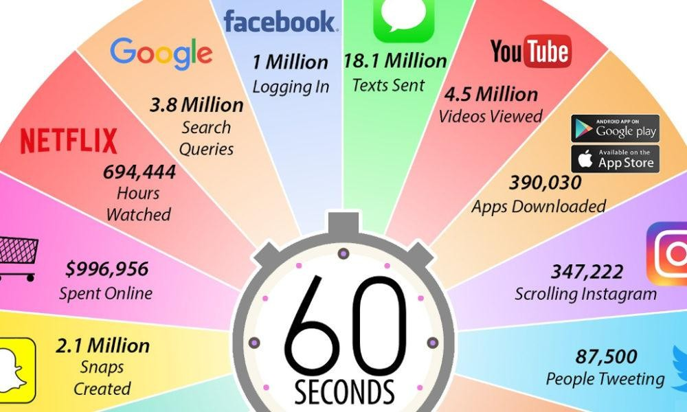
Due to the large amount of data, social media has become an important source of information for understanding human behavior.

Slide 5

Data mining techniques have been widely used in social media to extract insights to improve Business intelligence, provide better services and develop innovative opportunities.
Events refer to users’ behaviour in social media platforms and include a broad range of actions: joining a group, posting a question, commenting on a tweet, etc.
Events play a significant role in any dynamic system and all these events have a timestamp associated with them.

Slide 6
Statement of the Problem:
To provide and improve the efficiency of discovering the user's behavior patterns, detect deviating and undesired behavior, provide useful insights on the time perspective on social media data which reduces the ambiguity of providing correct answers to the users of platforms like Stack exchange.

Slide 7
Objectives:
To increase the usage of behavioral patterns in an effective way and to reduce data wastage and increase user readability.
To improve the efficiency of platforms like Stack exchange which helps in sharing knowledge by developing this model we can provide the apt and most preferred solutions to the user.
To decrease the time consumption while extracting the behavior patterns from the data.
To give the most desired answers for the questions posted on the website in a very quick manner.

Slide 8
Motivation:
As there are more and more questions posted on social media, people would like to find more likeable answers in an effective way.
The OCBC model is to give effective outputs or answers to the questions which will help the users like developers, researchers, customers and many others to get their results.
Sharing knowledge increases productivity and makes oneself work faster and smarter which helps in expertising and better problem so.
To predict what customers want before they ask for it and fix issues as they occur in real-time.
To share and promote the opinions, findings and researches on different fields to the user in a single platform.
Providing the most liked answers have become very important to reduce the difficulty.

Slide 9
Literature Survey:
Paper 1: G. Li, R. M. de Car valho, and W. M. P. Vander Aalst, “Automatic discovery of object-centric behavioral constraint models,” in Proc. Int. Conf. Bus. Inf. Syst., May 2017.
Title: Automatic Discovery of Object-Centric Behavioral Constraint Models.
Goal: To describe processes involving interacting instances and complex data dependencies using object-centric behavioral constraint model.
Methodology: The objects were used to find the patterns and behaviour of the models were discovered using basic ocbc model.

Slide 10
Algorithm :
Importing data from a social media website, Ex:Stack Exchange.
The data should be parsed and converted into the relational databases after scoping the data based on a particular need.
These databases were transferred into a XOC log files which can organize event data.
Process mining techniques will be applied on XOC log file.
The process will be discovered using object-centric behavioral constraint model.
Drawbacks: It failed to deal with conformance checking and also time consuming.

Slide 11
Paper 2: G. Barbier and H. Liu, “Data mining in social media,” Social Netw. DataAnal., vol. 17, pp. 327352, Mar. 2011.
Title: Data mining in social media.
Goal: This paper illustrates about basics of mining social media data using profiling algorithm and its networking sites.
Methodology: The classes are identified and directs the computer to classify accordingly and makes clusters/classes based on category or class name and mines the data in social media.

Slide 12
Profiling Algorithm:
a_{i}=block address of reference i
n=length of vectors
cost (v) = accumulated cost for vector v, initially 0
for each reference I in program trace do
if a_{i} is a compulsory miss then
push a_{i} to top of stack
end if
else /*Count conflict vectors*/
for each a_{j} on stack above a_{i} do
V=(a_{i} ⊕a_{j}) truncated to n bits increment cost(v)
end for
Move a_{i} to top of stack
end for
Drawbacks: This is not able to get the accurate output as their method can't generate accurate behavioral patterns.

Slide 13
Paper 3: W.M.P. van der Aalst, G. Li, and M. Montali, “Object-centric behavioral constraints,''Mar.2017.
Title: Object-centric behavioral constraints.
Goal: To describe the behavioral and data perspectives, and the interplay between them in a one single, hybrid diagram and to implement the approach as a plugin and evaluate it by comparing with other models.
Methodology: To show the interactions between the objects that which are extended and analysed to extract the behavior of the events and also to compare a process model with an event log of the same process to check whether everything is recorded or not using conformance checking.
Drawbacks: It failed to incorporate attributes into consideration which may lead to deviations in the conformance checking.

Slide 14
Paper 4: E. H. J. Nooijen, B. F. van Dongen, and D. Fahland, ‘‘Automatic discovery of data-centric and artifact-centric processes,’’ in Proc. Int. Bus.Process Manage.
Title: Automatic discovery of data-centric and artifact centric processes.
Goal: To automate the discovery of a process model from recorded executions of the process using process discovery technique.
Method: The technique which allows automatic discovery of process model from recorded event logs by extracting event information, case identifiers and their interrelations and by discovering the central process data objects and their associated events to decompose the data source into multiple logs through which all the possible variations can be known.

Slide 15
Process discovery Algorithm:
Require: A main artifact table T^{m}, base table T₀ (with primary key C_{ID}), a set of attribute table,
T_{attr}, a set of attribute columns C_{attr} and an artifact schema S, links to other tables of the artifact in the form of foreign keys F_{link.}
collect data from table T^{m}
for all T € (T_{one2one} \ T_{attr}) do
for all C € C_{T} \ C_{attr} do
AM 🡨 CreateAttributeMapping(C)
end for
end forfor all T € Tone2manydo
CreateMapping(T^{m}, T, T_{attr}, C_{attr})
end for
return general mapping item (C_{ID}, T_{from}, F_{link},)
Drawbacks: It failed to deal with large datasets and its evaluation.

Slide 16
Limitations of Existing Methods:
Data from online social media platforms are dynamic, regular modifications and updates over a short period are not common but also a significant aspect to consider in dealing with social media data can be noisy.
When you mine the social interaction, you try to get more information about the user than is visible at superficial layers.
Incorrect information can also be the main drawback of data mining systems. When a user interacts on the social platform, they don't always assure us that they're being pristimne in their thoughts.
Even though there are many mining techniques it is impossible to provide 100% correct solution due to noise.

Slide 17
Physical Model:
Social media
Data
Stack
exchange
Question and answer
Databases
User data
Applying OCBC
model
Extracting Behavioral patterns
Comments and likes
Most liked answer

Slide 18
Physical model can be shortly explained as,
1.Collecting data from social media platform like stack exchange.
2.Using OCBC approach the data will be parsed and imported into relational database.
3.The data will be transformed into event logs for process mining techniques to discover insights.
4.Timestamps will be assigned to event logs which corresponds to an activity.
5.Based on the event logs we can differentiate the activities and extract behavioral patterns.

Slide 19
Mathematical Model:
The engagement rate is a factor which is used to refer the level of interaction with followers that is generated from content created by a user. The engagement rate provides a more accurate representation of content performance than simply looking at absolute measures such as likes, shares, and comments. It is a popular equation used by most of the social media websites as it provides appropriate results while compared to other factors.

Slide 20
Proposed System:
1. Start
2. Import stackexchange API packages
3. Import sql connection
4. Include database.dmp file
5. Public class Logindao extends Dbcon
6. Con=getConnection
7. Create new arraylist <Profilebean>
8. preparedStatement ps=con.prepareStatement("Create table")
9. Public serializable extends Logindao
10. function profiling()
11. for reference i in Profilebean do
12. if category=user
13. Push user to user_stack
14. else
15. Push admin to admin_stack
16. for each admin in stack
17. if admindetails missing:
18. Truncate admin details

Slide 21
19. else
20. Move admin to top of stack
21. for each user in stack
22. if userdetails missing:
23. Truncate admin details
24. else
25. Move admin to top of stack
26. function process_discovery()
27. collect data from database
28. for all questions do:
29. Process=CreateAttributeMapping(comments,likes)
30. function Conformance checking()
function ocbc()
map process and event logs
31. for i in profilebean do:
32. verify mapping according to timestamps
33. Public class Profilebean implements serializable
34. if detailsRemaining! = 0:
35. Get arraylist<Profilebean>
36. While (readstring.next()):
37. Get database details
38. Verify login

Slide 22
39. If password matches:
40. Display registration successful
41. else:
42. Display registration failed
43. While details remaining!=0:
44. Call function profiling
45. Sort data based on user and admin category
46. Call function process_discovery
47. Form event logs
48. Call function conformance_checking
49. if category = User:
50. Access granted to View questions, comment and like
51. else:
52. Access granted to Add and delete questions, View questions, View users
53. Public class Registrationservlet extends Profilebean
54. for i in details:
55. if Question_added >= 1 || Comment_added >= 1 || like >= 1
56. Con=getConnection()
57. Update database using prepared statement

Slide 23
58. if like! = 0:
59. Count _likes++
60. else:
61. Count _likes--
62. while user! = 0:
63. Number_of_users ++
64. else:
65. Number_of_user --
66. for i in no_of_questions do
67. if user != 0 && like != 0:
68. Engagement_Rate = Count_likes/Number_of_users
69. else:
70. Engagement_Rate = 0
71. Public class RegistrationServlet extends Httpservlet
72. for i in no_of_questions do
73. if Engagement_Rate > = Maximum_Threshold:
74. Display best answer using ratings(Ex: Green stars)
75. else:
76. Display worst answers using ratings(Ex: red stars)
77. end

Slide 24
72. for i in no_of_questions do
73. if Engagement_Rate > = Maximum_Threshold:
74. Display best answer using ratings(Ex: Green stars)
75. else:
76. Display worst answers using ratings(Ex: red stars)
77. end

Slide 25
Software Requirements:
Operating system
:Windows7
:J2EE
: Tomcat
Coding Language
Server
Tool
: My Eclipse 8.6
Data Base
:Oracle 10 g

Slide 26
Hardware Requirements:
System
: Intel i3 Processor
Hard Disk
: 500 GB
Ram
: 8GB

Slide 27
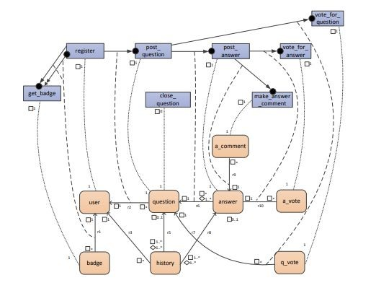
Simulation Model:
Fig: The reference model for conformance checking.
♦ represents Cardinality constraint
Represents parent id
Source: question
Target: primary - answer, secondary - like

Slide 28
Performance Evaluation:
The performance evaluation on usage of process mining and OCBC model can be split into independent analysis on so-called correlation patterns. Therefore, the most relevant pattern is the one which has “post question'' as reference and “post answer'' as target.
In this graph a pattern is considered to analyze performance of working model as P1: reference activity as post_question and target activity as post_answer. This Figure employs the dotted chart to present the performance analysis result for the pattern “P1”. The Y axis indicates that there are almost 2,150 instances while the X axis indicates that events in these instances happened.
●

Slide 29
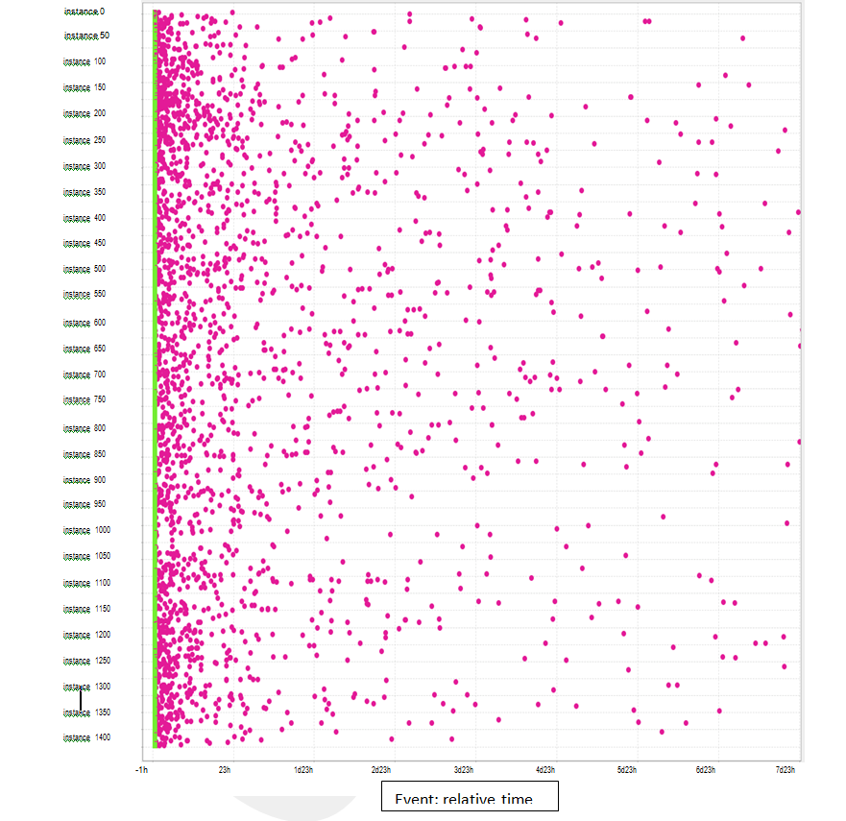
The performance analysis result corresponding to pattern P1, presented by the dotted chart in the absolute time.

Slide 30
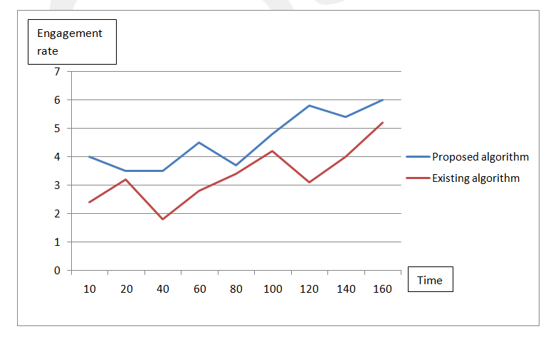
Analysis of Experiment data:
The quality of process mining can be measured using some key factors like Engagement rate, Behavioral patterns, Cardinality constraints, Conformance checking and many other factors.
Engagement rate /Time graph for existing system and proposed System

Slide 31
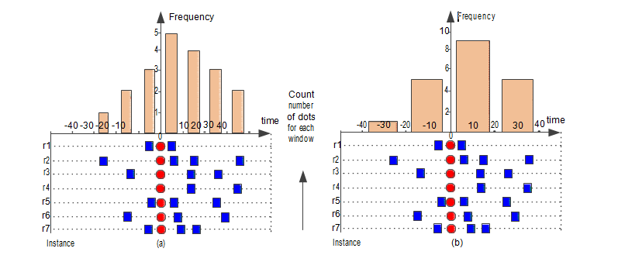
Two column charts based on window sizes of 10 (a) and 20 (b), respectively for conformance checking.
Where window size indicates the number of questions.
Indicates cardinality constraints
Indicates number of events

Slide 32
Conclusion:
The application process mining and OCBC techniques, to real life data from social media, such as Stack Exchange helps to show how to discover the user's behavior patterns, e.g., two patterns involving post, comment, answer activities in Stack exchange site, detect deviating and/or undesired behavior. Discover the users' behavior patterns. Detect deviating and/or undesired behavior, e.g., a question is posted without any answer in Stack Exchange, and Provide useful insights on the time perspective, e.g., most answers are given in one day after the corresponding questions are posted. Time complexity and human dependency will be reduced to great extent. By taking the data perspective into consideration, it is possible to detect and diagnose a range of conformance problems that would have remained undetected by conventional approaches.

Slide 33
References:
¨G. Barbier and H. Liu, “Data mining in social media,'' Social Netw. Data
Anal., vol. 17, pp. 327352, Mar. 2011.
¨G. Li, R. M. de Carvalho, and W. M. P. vander Aalst, “Automatic discovery of object-centric behavioral constraint models,'' in Proc. Int. Conf. Bus. Inf. Syst., May 2017, pp. 4358.
¨B. Pang and L. Lee, “Opinion mining and sentiment analysis,''Found. Trends Inf. Retr., vol. 2, nos. 12, pp. 1135, 2008.
¨W. M. P. van der Aalst, G. Li, and M. Montali, “Object-centric behavioral constraints,''Mar.2017.
¨G. Li, E. G. L. de Murillas, R. M. de Carvalho, andW. M. P. van der Aalst,``Extracting object-centric event logs to support process mining ondatabases,'' in Proc. Int.Springer. Jun. 2018, pp. 182199.
¨D.Gruhl, R.Guha, D.Liben-Nowell, and A.Tomkins, “Informationdiffusion through blogspace,'' in Proc. 13th Int. Conf. World Wide Web,May 2004, pp. 491501.

